Slide 1

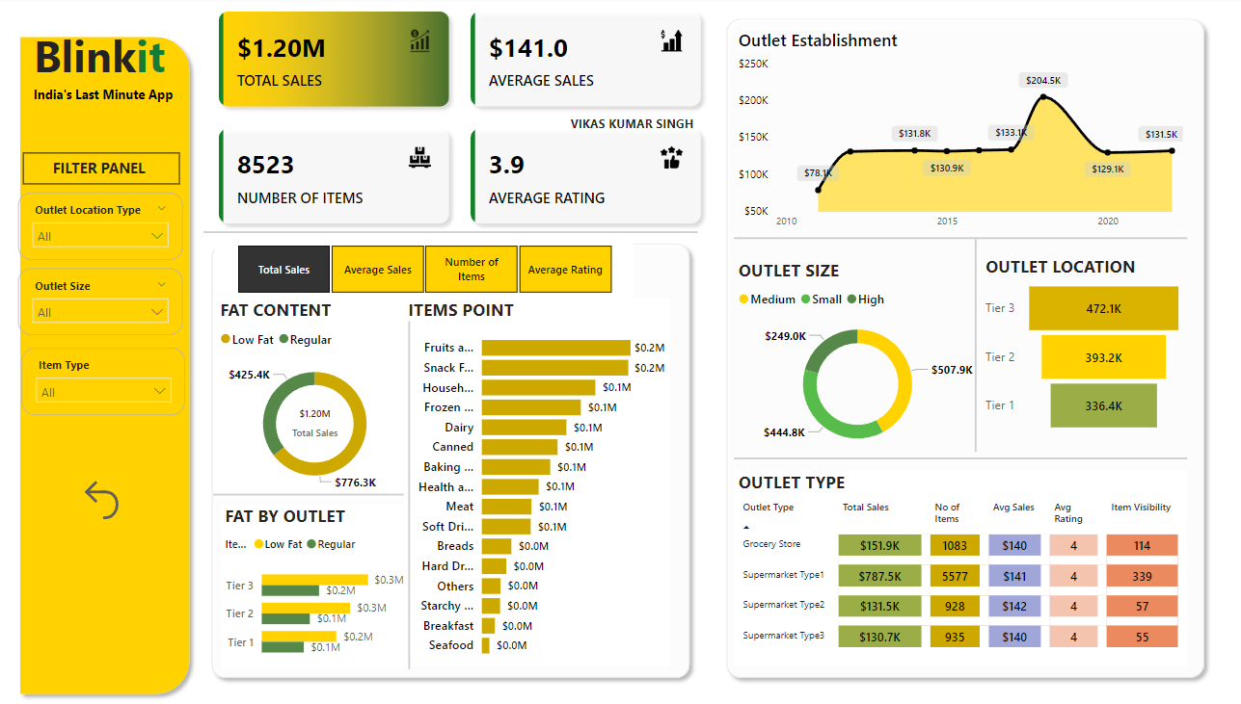

BLINKIT ANALYSIS
Presented By : Vikas Kumar Singh

Slide 2
BLINKIT ANALYSIS
STEPS IN PROJECT
Requirement Gathering/ Business Requirements
Data Walkthrough
Data Connection
Data Cleaning/Quality Check
Data Modelling
Data Processing
DAX Calculations
Dashboards Lay outing
Charts Developments and Formatting
Dashboard/Reports Developments
Insights Generations

Slide 3
BLINKIT ANALYSIS
BUSINESS REQUIREMENTS
To conduct a comprehensive analysis of Blinkit's sales performance, customer satisfaction, and inventory distribution to identify key insights and opportunities for optimization using various KPis and visualizations in Power BI.
KEY REQUIREMENTS
Total Sales: The overall revenue generated from all items sold
Average Sales: The average revenue per sale.
Number of Items: The total count of different items sold
Average Rating: The average customer rating for items sold.

Slide 4
BLINKIT ANALYSIS
BUSINESS REQUIREMENT
CHART’S REQUIREMENT
Total Sales by Fat Content:
Objective: Analyse the Impact of fat content on total sales.
Additional KPI Metrics : Assess how other KPIs (Average Sales, Number of Items, Average Rating) vary with fat content.
Chart Type : Donut Chart.
Total Sales by Item Type:
Objective: identify the performance of different item types in terms of total sales.
Additional KPI Metrics : Assess how other KPIs (Average Sales, Number of Items, Average Rating) vary with fat content.
Chart Type : Bar Chart
Fat Content by outlet for Total Sales:
Objective: Compare Total sales across different outlets segments by fat content
Additional KPI Metrics : Assess how other KPIs (Average Sales, Number of Items, Average Rating) vary with fat content.
Chart Type : Stacked column Chart.
Average Rating: The Average customer rating for items sold.
Objective: Evaluate how the age or type of Outlet establishment influence total sales.
Chart Type : Line Chart.

Slide 5
BLINKIT ANALYSIS
BUSINESS REQUIREMENT
Chart’s Requirement
5. Sales by outlet Size:
Objective: Analyse the correlation between outlet size and total Size.
Chart Type : Donut/ Pie Chart
6. Sales by outlet Location:
Objective: Assess the Geographic Distribution of sales across difference Locations.
Chart Type : Funnel Map
7. All Metrics by Outlet Type:
Objective: Provide a Comprehensive view of all key metrics(total sales, average sales, Number of item, Average Rating) broken down by different outlet types.
Chart Type : Matrix Card.

Slide 6
BLINKIT ANALYSIS
THANK YOU

